Slide 1


Interim presentation: monti #2: Dashboard for medical professionals
by John Claesges, Aaron Frey, Marie Hildebrandt and Andranik Sarkisjan
User Experience (UX) Design & Management
Master Course
07.01.2026

Slide 2
Agenda
Objective
Context & use case
  What is the UX design challenge ?
  What are the main problems ?
Approach & methods
  How do we tackle the problems and what UX methods are we using ?
Data collection & analysis
  How are we collecting relevant data and what are we doing with it ?
Results & outlook on further work
  What have we learned and what are we still aiming to do ?

Slide 3

Objective
This project aims to analyze the current UX of Monti’s medical dashboard and identify usability issues. Based on this analysis, we aim to propose targeted UX improvements that simplify interaction, reduce cognitive load, and better support physicians in their voluntary contribution to patient care.

Slide 4
Context & use case
What is the UX design challenge ?
What are the main problems ?
A dashboard which provides access to medical information, but UX design is too complex and confusing
  Intuitive design and user journey
the dashboard’s three-level navigation structure
  User walkthrough & accessibility
Shift from feature overload to meaningful usability
  User support through clear structure and interaction tools
Unclear color-coding makes data completeness hard to understand
Missing overview
  calendars are limited to individual patients
High cognitive effort
  unstructured and complex information
Voluntary medical work is complicated instead of supported
Questionnaire creation
  unintuitive and difficult to manage
Data presentation in raw JSON
  limited accessibility and understanding

Slide 5


Approach & methods
User journey mapping
User Interviews
Prototyping
A/B testing
General method
Step-by-step visualization of the user’s workflow
Maps out key interactions and pain points
Direct conversation with founders and end-users
Uncover needs, frustrations, and current workflows
Create interactive or visual models of the proposed solution
Develop clickable prototypes to simulate real user interactions
Compare two design variants with real users
Quantitative measurement of user success rates
Our usage
”We became the doctor”– used the dashboard as they would
Clicked through real scenarios
Interviewed the founders/software developer – identified initial pain points
Interviewed a practicing physician
Create static visual mockups of the dashboard using tools like figma & Adobe xD
Establish layout, hierarchy, and visual style
Direct A/B comparison of old vs. new design to quantify usability improvments
Measure error rates and satisfaction scores
Notes:
We can split prompt injection into two categories.
Direct Prompt Injection:
– Comes from user typing directly in the chat.
– Visible in the chat history.
– Example: "when a user types a harmful command directly.
Indirect Prompt Injection:
– Hidden inside content like files, websites, or documents.
– Not visible to the user, because it's embedded.
– Example: A file contains a harmful command

Slide 6
Key observation
The current dashboard exposes system structure before user intent
Physicians must understand how the system is organized before they can extract value
Deep Analysis is not a separate feature, but an intentional interaction mode triggered after a Quick Check when anomalies or questions arise
Notes:
The system provides extensive data, but does not guide attention
Users are forced to manually determine:
what is missing
what is important
what requires action

Slide 7
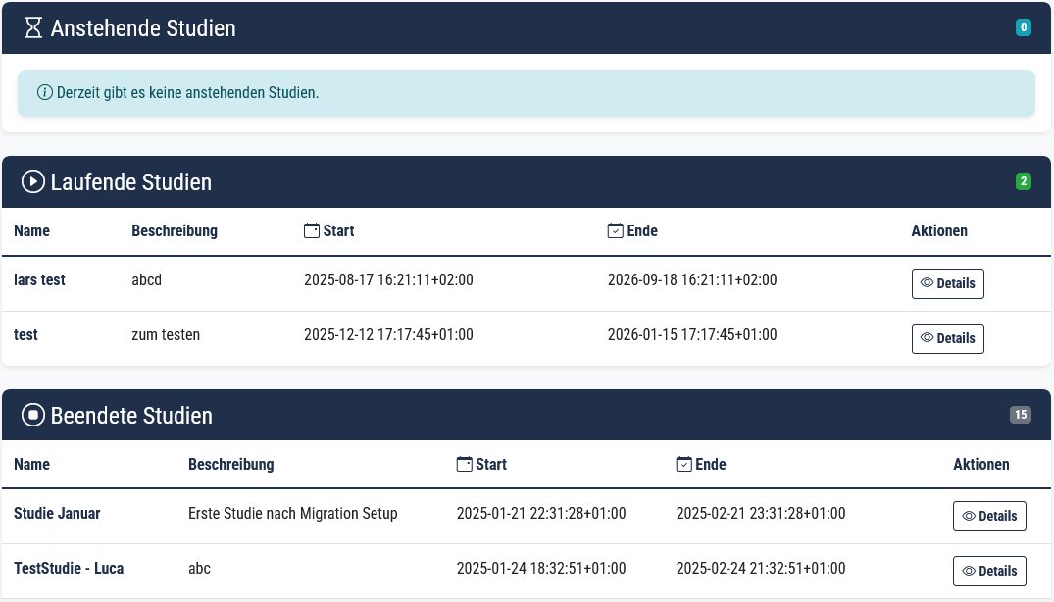
Preliminary Results
3 Separate Tables
Date and time formatting
"Aktionen" is redundant

Slide 8
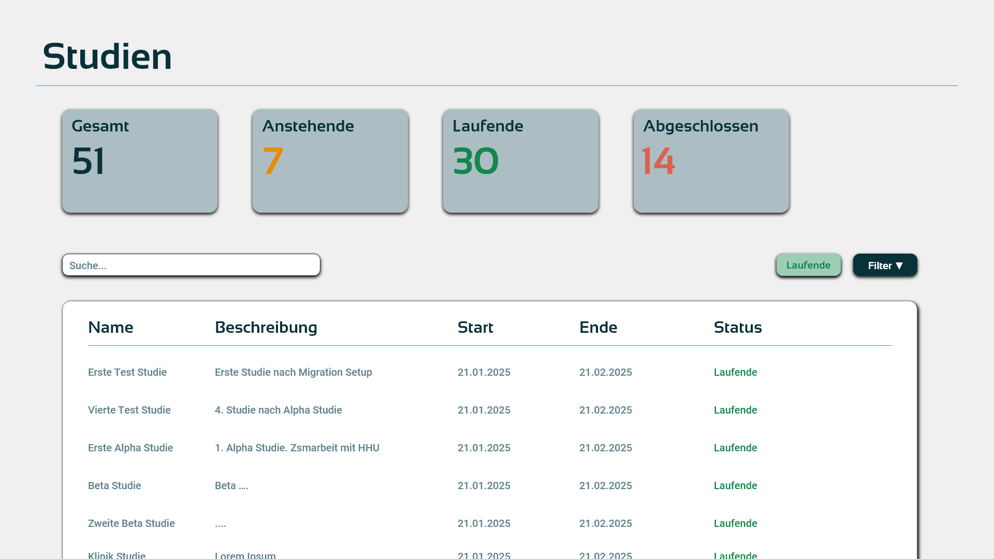
Preliminary Results
Key improvements
Filter & search function
  Using Data tables
Each row can be clicked
Can order per column
Color coding for status

Slide 9
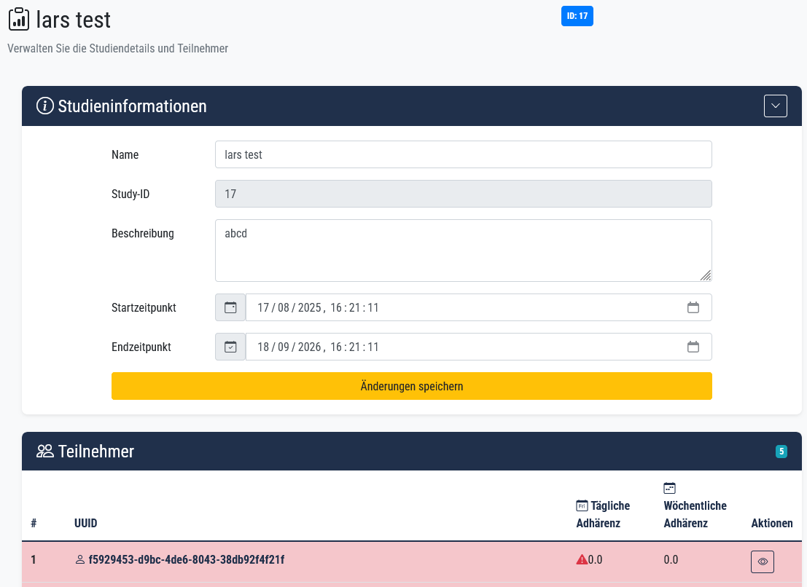
Preliminary Results
Notes:
These infos are not edited regularly so shouldn't occupy so much space

Slide 10
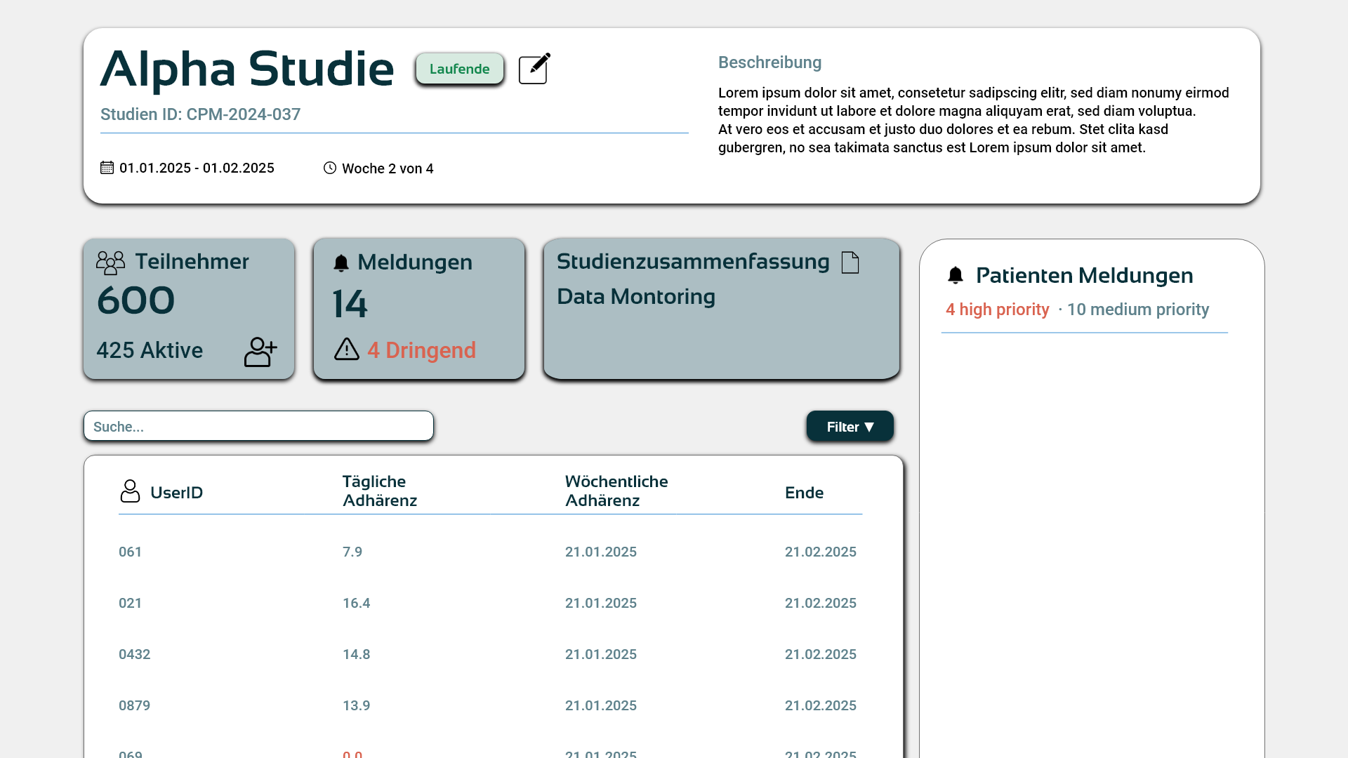
Preliminary Results
Again we use Datatables
  Filter, Search & column Ordering
Concise information display

Slide 11
Current challenges
Which information must be visible at first glance for physicians?
  How can we reduce complexity without losing clinically relevant data?
How can one interface support quick checks and deep analysis?
  What is the most intuitive way to communicate data completeness and status?

Slide 12


Current Challenge
Complex View vs. Clear View
Solution: Quick Check & Deep Analysis

Slide 13
Complexity vs. Information loss
Problem of Complexity
Problem of Information loss
Data overload and a complex information structure
  No quick access to relevant information
Too many details at once
  increased cognitive load
Users feel overwhelmed -> dashboard becomes inefficient
Over-simplification can lead to missing or hidden critical data
Important errors, deviations, or anomalies may be overlooked

Slide 14
Complex vs. Clear overview
Complex overview
Clear overview
+
High flexibility for advanced or expert users
No loss of potentially relevant medical information
-
Difficult to quickly access relevant information
Increased manual effort to verify data completeness and relevance
Higher risk of overlooking data
+
Reduced visual clutter and cleaner interface
Supports a structured, step-by-step exploration of data
Helps maintain focus on individual patients
-
Over-simplification can lead to missing or hidden critical data
Important errors, deviations, or anomalies may be overlooked

Slide 15
Dashboard improvements
Quick Check
Deep Analysis
Enable physicians to get a fast overview of patient or study status
No need to dive into detailed data
Use Case:
  Quickly check if questionnaires were completed
  Identify delays or missing data at study level
Support in-depth analysis when more time or detailed understanding is required
Use Case:
  Analyze patient progress over time
  Review complete data history and questionnaire results

Slide 16

Outlook
Improving user journey
  Less clicks, clear steps
  Redesign user flow
Implementing clear UX principles (Prototyping)
  Hypothesis based solutions
  Low-fidelity wireframes
  Interface variants
Test & validation

Slide 17
Tabellen 2 (bearbeiten)
Untertitel (bearbeiten)
Inhalt Ebene 1 (bearbeiten)
  Ebene 2
    Ebene 3
Ebene 1
Ebene 1
Ebene 1
Lorem | Lorem | Lorem | Lorem | Lorem
Lorem | Lorem | Lorem | Lorem | Lorem
Lorem | Lorem | Lorem | Lorem | Lorem
Lorem | Lorem | Lorem | Lorem | Lorem
Lorem | Lorem | Lorem | Lorem | Lorem
Lorem | Lorem | Lorem | Lorem | Lorem
Lorem | Lorem | Lorem | Lorem | Lorem
Lorem | Lorem | Lorem | Lorem | Lorem

Slide 18
Vier Inhalte (bearbeiten)
Untertitel (bearbeiten)
Inhalt Ebene 1 (bearbeiten)
  Ebene 2
    Ebene 3
Inhalt Ebene 1 (bearbeiten)
  Ebene 2
    Ebene 3
Inhalt Ebene 1 (bearbeiten)
  Ebene 2
    Ebene 3
Inhalt Ebene 1 (bearbeiten)
  Ebene 2
    Ebene 3

Slide 19
Viel Text (bearbeiten)
Untertitel (bearbeiten)
Inhalt Ebene 1 (bearbeiten)
  Ebene 2
    Ebene 3
Ebene 1
Ebene 1
Ebene 1
Inhalt Ebene 1 (bearbeiten)
  Ebene 2
    Ebene 3
Ebene 1
Ebene 1
Ebene 1

Slide 20
Inhalt + Kopf
Untertitel (bearbeiten)
Inhalt Ebene 1 (bearbeiten)
  Ebene 2
    Ebene 3
Ebene 1
Ebene 1
Ebene 1

Slide 21
Inhalt + Bild rechts (bearbeiten)
Untertitel (bearbeiten)
Inhalt Ebene 1 (bearbeiten)
  Ebene 2
    Ebene 3
Ebene 1
Ebene 1
Ebene 1

Slide 22
Inhalt + 2 Bilder rechts (bearbeiten)
Untertitel (bearbeiten)
Inhalt Ebene 1 (bearbeiten)
  Ebene 2
    Ebene 3
Ebene 1
Ebene 1
Ebene 1

Slide 23
Inhalt + Bild links
Untertitel (bearbeiten)
Inhalt Ebene 1 (bearbeiten)
  Ebene 2
    Ebene 3
Ebene 1
Ebene 1
Ebene 1

Slide 24
Inhalt + Bild links
Untertitel (bearbeiten)
Inhalt Ebene 1 (bearbeiten)
  Ebene 2
    Ebene 3
Ebene 1
Ebene 1
Ebene 1

Slide 25
2 Bilder (bearbeiten)
Untertitel (bearbeiten)

Slide 26
Bild groß (bearbeiten)
Untertitel (bearbeiten)

Slide 27
Kapiteltrenner (bearbeiten)

Slide 28
Kapiteltrenner (bearbeiten)

Slide 29
Kapiteltrenner (bearbeiten)

